Slide 1
Memory Organization:
Memory Hierarchy, Main Memory, Auxiliary Memory
(Lecture 54-57)

Slide 2
.
INDEX
Introduction
Memory Definitions
Memory Characteristics
Memory Hierarchy
Main Memory
Auxiliary Memory

Slide 3
Introduction
The memory unit is an essential component in any digital computer since It is needed for storing programs and data.
The memory unit that communicates directly with the CPU is called the main memory.
Most general purpose computers would run more efficiently if they were equipped with additional storage beyond the capacity of the main memory.
Devices that provide backup storage are called auxiliary memory. The most common auxiliary memory devices used in computer systems are magnetic disks and tapes. They are used for storing system programs, large data files, and other backup information.
Only pro­grams and data currently needed by the processor reside in main memory. All other information is stored in auxiliary memory and transferred to main memory when needed.
The total memory capacity of a computer can be visualized as being a hierarchy of components.

Slide 4
Memory Definitions
Memory ─ A collection of storage cells together with the necessary circuits to transfer information to and from them.
Memory Organization ─ the basic architectural structure of a memory in terms of how data is accessed.
Memory Address ─ A vector of bits that identifies a particular memory element (or collection of elements).
Memory Management System - The part of the computer system that supervises the flow of information between auxiliary memory and main memory is called the memory management system.
Typical data elements are:
bit ─ a single binary digit
byte ─ a collection of eight bits accessed together
word ─ a collection of binary bits whose size is a typical unit of access for the memory. It is typically a power of two multiple of bytes (e.g., 1 byte, 2 bytes, 4 bytes, 8 bytes, etc.)

Slide 5
Memory Characteristics
The memory system can be characterized on the basis of following parameters.
Location: Where it can be located, Processor, Internal, External .
Capacity: size in terms of bytes, KB, MB, GB, etc…
Unit of transfer: How many bits can be moved like bytes, words, Blocks, etc….
Access method and Time: How you pick of data Sequential, Direct, Random, etc…
Performance: Transfer rate n terms of bps
Physical type: Which material we are using like semiconductor, Magnetic, Optical, etc…
Physical characteristics: like power consumption, information loss, volatile, etc…
Organization: How it stored like continues, interleaved, etc….

Slide 6
Memory Technologies
There are four primary technologies used today in memory hierarchies.
Main memory is implemented from DRAM (dynamic random access memory), while levels closer to the processor (caches) use SRAM (static random access memory).
DRAM is less costly per bit than SRAM, although it is substantially slower. The price difference arises because DRAM uses significantly less area per bit of memory, and DRAMs thus have larger capacity for the same amount of silicon; the speed difference arises from several factors.
The third technology is flash memory. This non volatile memory is the secondary memory in Personal Mobile Devices.
The fourth technology, used to implement the largest and slowest level in the hierarchy in servers, is magnetic disk.

Slide 7
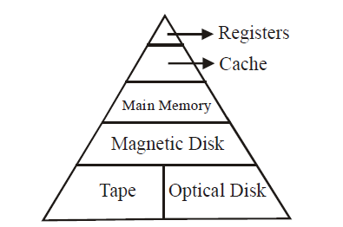
Memory Hierarchy
The memory hierarchy consists of the total memory system of any computer. The memory components range from higher capacity slow auxiliary memory to a relatively fast main memory to cache memory that can be accessible to the high speed processing logic. A five-level memory hierarchy is shown in below figure. Memory Hierarchy is to obtain the highest possible access speed while minimizing the total cost of the memory system.
Fig. Five-level Memory Hierarchy
Increase in capacity
Increase in access time
Increase in cost per bit

Slide 8
Memory Hierarchy (Cont..)
At the top of this hierarchy, there is a Central Processing Unit (CPU) register which is accessed at full CPU speed. Registers are local memory to the CPU as the CPU requires it.
Next comes cache memory. The cache memory is employed in computer systems to compensate for the speed differential between main memory access time and processor logic. Cache is very small but has very high access speed and is relatively expensive. Thus, we can say that
Access speed ∝ Cost
3. After that, is the main memory with sizes currently ranging from 16 MB for an entry level system to few gigabytes at the other end.
4. Next are magnetic disks, and used as secondary storage are called auxiliary memory.
5. Finally we have devices that provide backup storage are called auxiliary memory. The most common auxiliary memory devices used in computer systems are magnetic tapes and optical disk.

Slide 9
Memory Hierarchy (Cont..)
The memory, as we move down the hierarchy, mainly depends on the following three key parameters:
Access Time,
Storage Capacity,
Cost.
Memory Connection to CPU

Slide 10
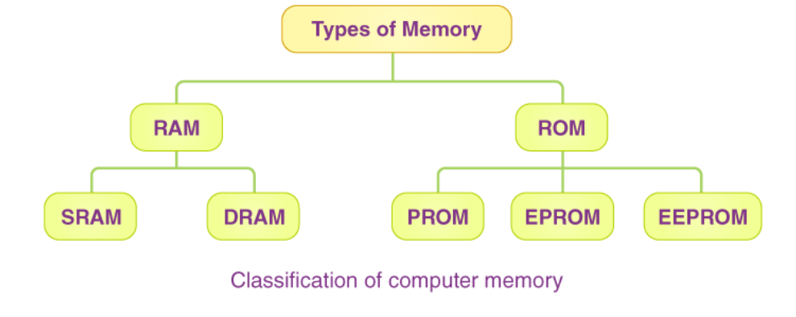
Main (Primary) Memory
The main memory is the central storage unit in a computer system. It is a relatively large and fast memory used to store programs and data during the computer operation. We can broadly classify Primary Memory into two parts:
1. Read-Only Memory or ROM
2. Random Access Memory or RAM

Slide 11
Main (Primary) Memory
The principal technology used for the main memory is based on semiconductor integrated circuits. Integrated circuit RAM chips are available in two possible operating modes, static and dynamic.
The static RAM consists essentially of internal flip-flops that store the binary information. The stored information remains valid as long as power is applied to the unit.
The dynamic RAM stores the binary information in the form of electric charges that are applied to capacitors. The capacitors are provided inside the chip by MOS transistors. The stored charge on the capacitors tend to discharge with time and the capacitors must be periodically recharged by refreshing the dynamic memory.
Refreshing is done by cycling through the words every few milliseconds to restore the decaying charge.
The dynamic RAM offers reduced power consumption and larger storage capacity in a single memory chip whereas static RAM is easier to use and has shorter read and write cycles.
Most of the main memory in a general-purpose computer is made up of RAM integrated circuit chips, but a portion of the memory may be constructed with ROM chips.

Slide 12
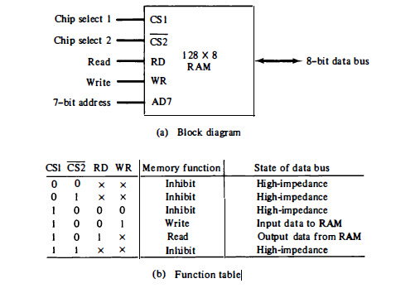
RAM: Main (Primary) Memory
The term, Random Access Memory (RAM), is basically applied to the memory system that is easily read from and written to by the processor. For a memory to be random access means that any address can be accessed at any time, i.e., any memory, location can be accessed in a random manner without going through any other memory location. The access search time for each memory location is same. The block diagram of a RAM chip is shown in below figure.
Typical RAM Chip (The capacity of
the memory is 128 words of eight bits per word. This requires a 7-bit address and an 8-bit bidirectional data bus)

Slide 13
RAM Pin Description
The read and write inputs specify the memory operation and the two chips select (CS) control inputs are for enabling the chip only when it is selected by the microprocessor.
The availability of more than one control input to select the chip facilitates the decoding of the address lines when multiple chips are used in the microcomputer.
The function table listed in last slide specifies the operation of the RAM Chip. The unit is in operation only when CS1 = 1 and CS2 = 0. The bar on top of the second select variable indicates that this input is enabled when it is equal to 0.
If the chip select inputs are not enabled, or if they are enabled but the read or write inputs are not enabled, the memory is inhibited and its data bus is in a high-impedance state.
When CS1 = 1 and CS2 = 0, the memory can be placed in a write or read mode. When the WR input is enabled, the memory stores a byte from the data bus into a location specified by the address input lines.
When the RD input is enabled, the content of the selected byte is placed into the data bus. In this data can be output from RAM.

Slide 14
Classification of RAM
The two main classifications of RAM are Static RAM (SRAM) and Dynamic RAM (DRAM).
Static RAM or SRAM is made from an array of flip-flops where each flip-flop maintains a single bit of data within a single memory address or location.
SRAM is a type of RAM that holds its data without external refresh as long as power is supplied to the circuit. The word ‘static’ indicates that the memory retains its content as long as power is applied to the circuit.
Dynamic RAM is a type of RAM that only holds its data if it is continuously accessed by special logic called refresh circuit. This circuitry reads the contents of each memory cell many hundreds of times per second to find out whether the memory cell is being used at that time by computer or not.
Due to the way in which DRAM memory cells are constructed, the reading action itself refreshes the contents of the memory. If this is not done regularly, then DRAM will lose its contents even if it continues to have power supplied to it. Because of this refreshing action, the memory is called dynamic.

Slide 15
SRAM and DRAM
RAM Key features
RAM is packaged as a chip
Basic storage unit is a cell (one bit per cell)
Multiple RAM chips form a memory
Static RAM (SRAM)
Each cell stores bit using a latch and a six-transistor circuit
Retains value indefinitely, as long as it is kept powered
Relatively insensitive to disturbances such as electrical noise
Faster and more expensive than DRAM
SRAM is used in CPU caches and registers
Dynamic RAM (DRAM)
Each cell stores bit with a capacitor and transistor
Value must be refreshed every 10-100 ms
Sensitive to disturbances
Slower and cheaper than SRAM
DRAM is mostly used for main memory

Slide 16
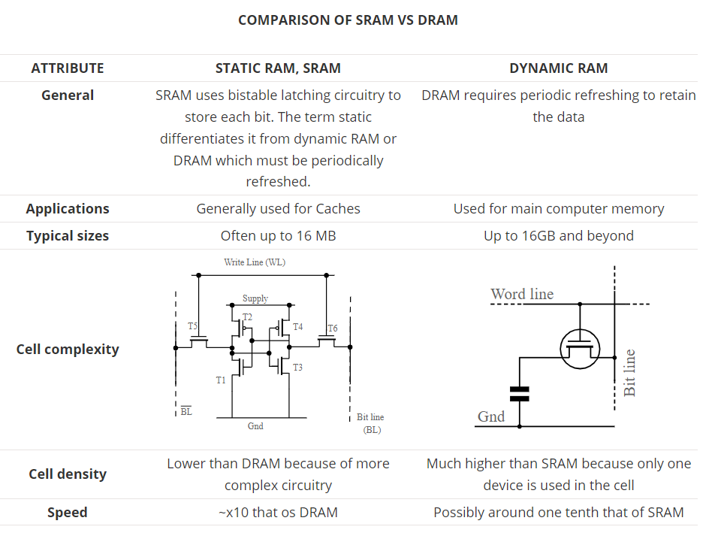
SRAM vs DRAM

Slide 17
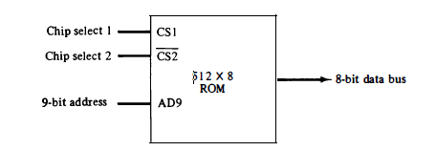
ROM: Main (Primary) Memory
ROM, which stands for read-only memory, is non-volatile memory that permanently stores instructions for your computer, although ROM is also random access.
The ROM portion of main memory is needed for storing an initial program called a bootstrap loader. The bootstrap loader is a program whose function is to start the computer software operating when power is turned on. The startup of a computer consists of turning the power on and starting the execution of an initial program. Thus when power is turned on, the hardware of the computer sets the program counter to the first address of the bootstrap loader. The bootstrap program loads a portion of the operating system from disk to main memory and control is then transferred to the operating system, which prepares the computer for general use. ROM chips are also available in a variety of sizes.
Typical ROM Chip

Slide 18
ROM Pin Description
The block diagram of a ROM chip is shown in previous slide.
A ROM chip is organized externally in a similar manner to RAM.
However, since a ROM can only read, the data bus can only be in an output mode.
For the same-size chip, it is possible to have more bits of ROM than of RAM, because the internal binary cells in ROM occupy less space than in RAM. For this reason, the diagram specifies a 512-byte ROM, while the RAM has only 128 bytes.
The nine address lines in the ROM chip specify any one of the 512 bytes stored in it.
The two chip select inputs must be CS1 = 1 and CS2 = 0 for the unit to operate. Otherwise, the data bus is in a high-impedance state.
There is no need for a read or write control because the unit can only read.
Thus when the chip is enabled by the two select inputs, the byte selected by the address lines appears on the data bus.

Slide 19
Classification of ROM
There are different types of ROMs. They are as follows:
PROM or Programmable Read Only Memory: Data is written into a ROM at the time of manufacture. However, the contents can be programmed by a user with a special PROM programmer. PROM provides flexible and economical storage for fixed programs and data.
EPROM or Erasable Programmable Read Only Memory: This allows the programmer to erase the contents of the ROM and reprogram it. The contents of EPROM cells can be erased using ultra violet light using an EPROM programmer. This type of ROM provides more flexibility than ROM during the development of digital systems. Since they are able to retain the stored information for longer duration, any change can be easily made.
EEPROM or Electrically Erasable Programmable Read Only Memory: In this type of ROM, the contents of the cell can be erased electrically by applying a high voltage. EEPROM need not be removed physically for reprogramming.

Slide 20
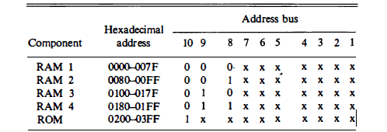
Memory Address Map
The designer of a computer system must calculate the amount of memory required for the particular application and assign it to either RAM or ROM.
The interconnection between memory and processor is then established from knowledge of the size of memory needed and the type of RAM and ROM chips available.
The addressing of memory can be established by means of a table that specifies the memory address assigned to each chip. The table, called a memory address map, is a pictorial representation of assigned address space for each chip in the system.
To demonstrate with a particular example, assume that a computer system needs 512(4*128) bytes of RAM and 512 bytes of ROM. The RAM and ROM chips to be used are specified in last slides. The memory address map for this configuration is shown below.
Memory address map for microcomputer

Slide 21
Memory Address Map (Cont..)
The component column specifies whether a RAM or a ROM chip is used.
The hexadecimal address column assigns a range of hexadecimal equivalent addresses for each chip. The first hexadecimal digit (group of 4 bits) represents lines 13 to 16 and is always 0. The next hexadecimal digit represents lines 9 to 12, but lines 11 and 12 are always 0.
The address bus lines are listed in the third column. Although there are 16 lines in the address bus, the table shows only 10 lines because the other 6 are not used in this example and are assumed to be zero.
The small x's under the address bus lines designate those lines that must be connected to the address inputs in each chip.
The RAM chips have 128 bytes and need seven address lines.
The ROM chip has 512 bytes and needs 9 address lines.
The x's are always assigned to the low-order bus lines: lines 1 through 7 for the RAM and lines 1 through 9 for the ROM.
It is now necessary to distinguish between four RAM chips by assigning to each a different address. For this particular example we choose bus lines 8 and 9 to represent four distinct binary combinations. Note that any other pair of unused bus lines can be chosen for this purpose.

Slide 22
Memory Address Map (Cont..)
The table clearly shows that the nine low-order bus lines constitute a memory space for RAM equal to 2^9 = 512 bytes.
The distinction between a RAM and ROM address is done with another bus line. Here we choose line 10 for this purpose. When line 10 is 0, the CPU selects a RAM, and when this line is equal to 1, it selects the ROM.
The equivalent hexadecimal address for each chip is obtained from the information under the address bus assignment. The address bus lines are subdivided into groups of four bits each so that each group can be represented with a hexadecimal digit.
The first hexadecimal digit represents lines 13 to 16 and is always 0 so 1st digit of addresses is 0. The next hexadecimal digit represents lines 9 to 12, but lines 11 and 12 are always 0.
The range of hexadecimal addresses for each component is determined from the x's associated with it. These x's represent a binary number that can range from an all-0's to an all-1's value.

Slide 23
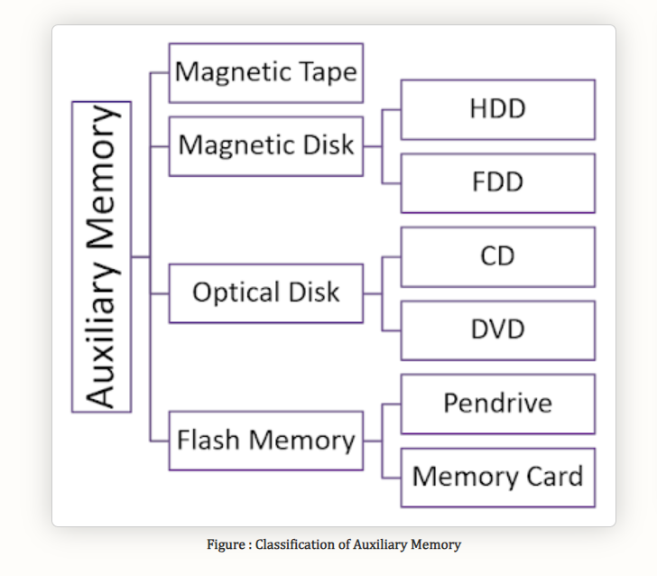
Auxiliary Memory and Classification
The most common auxiliary memory devices used in computer systems are magnetic disks and tapes. Other components used, but not as frequently, are magnetic drums, magnetic bubble memory, and optical disks as shown in below figure. This is a permanent storage and does not lose any data when power is switched off so called non volatile memory.
Auxiliary storage is also referred to as secondary or external storage as it is not embedded in our system memory (RAM) and needs to be provided through external cables or other storage media like Pen drives, DVDs and CDs.

Slide 24
Auxiliary Memory (Cont..)
In electromechanical devices with moving parts such as disks and tapes, the access time consists of a seek time required to position the read-write head to a location and a transfer time required to transfer data to or from the device. Because the seek time is usually much longer than the transfer time, auxiliary storage is organized in records or blocks.
The average time required to reach a storage location in memory and obtain its contents is called the access time.
A record is a specified number of characters or words. Reading or writing is always done on entire records. The transfer rate is the number of characters or words that the device can transfer per second, after it has been positioned at the beginning of the record.
Magnetic drums and disks are quite similar in operation. Both consist of high-speed rotating surfaces coated with a magnetic recording medium. The rotating surface of the drum is a cylinder and that of the disk, a round flat plate.
The recording surface rotates at uniform speed and is not started or stopped during access operations. Bits are recorded as magnetic spots on the surface as it passes a stationary mechanism called a write head.
Stored bits are detected by a change in magnetic field produced by a recorded spot on the surface as it passes through a read head. The amount of surface available for recording in a disk is greater than in a drum of equal physical size.
Therefore, more information can be stored on a disk than on a drum of comparable size. For this reason, disks have replaced drums in more recent computers.

Slide 25
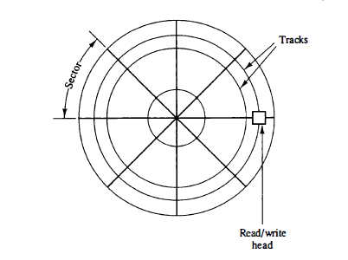
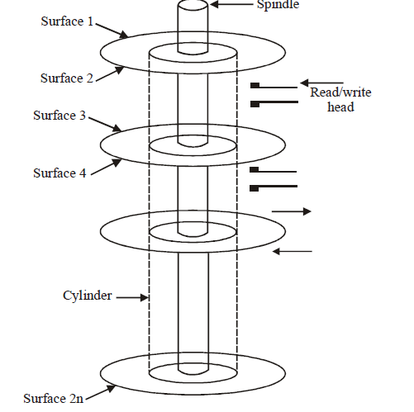
Magnetic Disks
A magnetic disk is a circular plate constructed of metal or plastic coated with magnetized material. Often both sides of the disk are used and several disks may be stacked on one spindle with read/write heads available on each surface.
All disks rotate together at high speed and are not stopped or started for access purposes. Bits are stored in the magnetized surface in spots along concentric circles called tracks.
The tracks are commonly divided into sections called sectors. In most systems, the minimum quantity of information which can be transferred is a sector. The subdivision of one disk surface into tracks and sectors is shown in below figure.
Fig: Disk Surface
Fig: Magnetic Disk

Slide 26
Disk Geometry
Disks consist of platters, each with two surfaces
Each surface consists of concentric rings called tracks
Each track consists of sectors separated by gaps
tracks
surface
track k
gaps
spindle
sectors

Slide 27
Disk Geometry (Multiple-Platter View)
Aligned tracks form a cylinder
cylinder k
surface 0
platter 0
surface 1
surface 2
platter 1
surface 3
surface 4
platter 2
surface 5
spindle

Slide 28
Disk Operation (Single-Platter View)
The disk surface
spins at a fixed
rotational rate
Read/write head
is attached to end
of the arm and flies over
disk surface on
thin cushion of air
spindle
spindle
By moving radially, arm can position read/write head over any track

Slide 29
Disk Operation (Multi-Platter View)
read/write heads
move in unison
from cylinder to cylinder
arm
spindle

Slide 30
Disk Structure - top view of single platter
Surface organized into tracks
Tracks divided into sectors
Notes:
Goal:
Show the inefficeincy of current disk requests.
Conveyed Ideas:
Rotational latency is wasted time that can be used to service tasks
Background Information:
None.
Slide Background:
None.
Kill text and arrows

Slide 31
Disk Access
Head in position above a track
Notes:
Goal:
Show the inefficeincy of current disk requests.
Conveyed Ideas:
Rotational latency is wasted time that can be used to service tasks
Background Information:
None.
Slide Background:
None.
Kill text and arrows

Slide 32
Disk Access
Rotation is counter-clockwise
Notes:
Goal:
Show the inefficeincy of current disk requests.
Conveyed Ideas:
Rotational latency is wasted time that can be used to service tasks
Background Information:
None.
Slide Background:
None.
Kill text and arrows

Slide 33
Disk Access – Read
About to read blue sector
Notes:
Goal:
Show the inefficeincy of current disk requests.
Conveyed Ideas:
Rotational latency is wasted time that can be used to service tasks
Background Information:
None.
Slide Background:
None.
Kill text and arrows

Slide 34
Disk Access – Read
After BLUE read
After reading blue sector
Notes:
Goal:
Show the inefficeincy of current disk requests.
Conveyed Ideas:
Rotational latency is wasted time that can be used to service tasks
Background Information:
None.
Slide Background:
None.
Kill text and arrows

Slide 35
Disk Access – Read
After BLUE read
Red request scheduled next
Notes:
Goal:
Show the inefficeincy of current disk requests.
Conveyed Ideas:
Rotational latency is wasted time that can be used to service tasks
Background Information:
None.
Slide Background:
None.
Kill text and arrows

Slide 36
Disk Access – Seek
After BLUE read
Seek for RED
Seek to red’s track
Notes:
Goal:
Show the inefficeincy of current disk requests.
Conveyed Ideas:
Rotational latency is wasted time that can be used to service tasks
Background Information:
None.
Slide Background:
None.
Kill text and arrows

Slide 37
Disk Access – Rotational Latency
After BLUE read
Seek for RED
Rotational latency
Wait for red sector to rotate around
Notes:
Goal:
Show the inefficeincy of current disk requests.
Conveyed Ideas:
Rotational latency is wasted time that can be used to service tasks
Background Information:
None.
Slide Background:
None.
Kill text and arrows

Slide 38
Disk Access – Read
After BLUE read
Seek for RED
Rotational latency
After RED read
Complete read of red
Notes:
Goal:
Show the inefficeincy of current disk requests.
Conveyed Ideas:
Rotational latency is wasted time that can be used to service tasks
Background Information:
None.
Slide Background:
None.
Kill text and arrows

Slide 39
Disk Access – Service Time Components
After BLUE read
Seek for RED
Rotational latency
After RED read
Seek
Rotational Latency
Data Transfer
Notes:
Goal:
Show the inefficeincy of current disk requests.
Conveyed Ideas:
Rotational latency is wasted time that can be used to service tasks
Background Information:
None.
Slide Background:
None.
Kill text and arrows

Slide 40
Disk Access Time
Average time to access some target sector approximated by (where T is time) :
Taccess = Tavg seek + Tavg rotation + Tavg transfer
Seek time (Tavg seek)
Time to position heads over cylinder containing target sector
Typical Tavg seek = 9 ms
Rotational latency (Tavg rotation)
Time waiting for first bit of target sector to pass under r/w head
Tavg rotation = 1/2 x 1/RPMs x 60 sec/1 min
Transfer time (Tavg transfer)
Time to read the bits in the target sector.
Tavg transfer = 1/RPM x 1/(avg # sectors/track) x 60 secs/1 min

Slide 41
Disk Access Time Example
Given:
Rotational rate = 7,200 RPM
Average seek time = 9 ms
Avg # sectors/track = 400
Derived:
Tavg rotation = 1/2 x (60 secs/7200 RPM) x 1000 ms/sec = 4 ms
Tavg transfer = 60/7200 RPM x 1/400 secs/track x 1000 ms/sec = 0.02 ms
Taccess = 9 ms + 4 ms + 0.02 ms
Important points:
Access time dominated by seek time and rotational latency
First bit in a sector is the most expensive, the rest are free
SRAM access time is about 4 ns/doubleword, DRAM about 60 ns
Disk is about 40,000 times slower than SRAM, and
2,500 times slower then DRAM

Slide 42
Magnetic Disks (Cont..)
Some units use a single read/write head for each disk surface. In this type of unit, the track address bits are used by a mechanical assembly to move the head into the specified track position before reading or writing.
In other disk systems, separate read/write heads are provided for each track in each surface. The address bits can then select a particular track electronically through a decoder circuit.
This type of unit is more expensive and is found only in very large computer systems. Permanent timing tracks are used in disks to synchronize the bits and recognize the sectors.
A disk system is addressed by address bits that specify the disk number, the disk surface, the sector number and the track within the sector. After the read/write heads are positioned in the specified track, the system has to wait until the rotating disk reaches the specified sector under the read/write head.
Information transfer is very fast once the beginning of a sector has been reached. Disks may have multiple heads and simultaneous transfer of bits from several tracks at the same time.

Slide 43
Magnetic Disks (Cont..)
A track in a given sector near the circumference is longer than a track near the center of the disk If bits are recorded with equal density, some tracks will contain more recorded bits than others.
To make all the records in a sector of equal length, some disks use a variable recording density with higher density on tracks near the center than on tracks near the circumference. This equalizes the number of bits on all tracks of a given sector.
Disks that are permanently attached to the unit assembly and cannot be removed by the occasional user are called hard disks. A disk drive with removable disks is called a floppy disk. The disks used with a floppy disk drive are small removable disks made of plastic coated with magnetic recording material.
There are two sizes commonly used, with diameters of 5.25 and 3. 5 inches. The 3.5-inch disks are smaller and can store more data than can the 5.25-inch disks.
Floppy disks are extensively used in personal computers as a medium for distributing software to computer users.

Slide 44
Magnetic Disks (Cont..)
Suppose s bytes are stored per sector, there are p sectors per track, t tracks per surface and m surfaces. Then, the capacity of disk will be defined as
Capacity = m × t × p × s bytes
Number of sectors (s) = m ×t ×p
Bits required to specify a particular sector = Log₂ s = n
If d is the diameter of the disk, the density of recording is
Density = (p × s)/(𝜋 ×d) bytes/inch
Determine the bits required to specify a particular sector if m=32, t=64, p=1024, s=512.

Slide 45
Magnetic Tape
A magnetic tape transport consists of the electrical, mechanical, and electronic components to provide the parts and control mechanism for a magnetic-tape unit.
The tape itself is a strip of plastic coated with a magnetic recording medium. Bits are recorded as magnetic spots on the tape along several tracks.
Usually, seven or nine bits are recorded simultaneously to form a character together with a parity bit. Read/write heads are mounted one in each track so that data can be recorded and read as a sequence of characters.
Tape units can be stopped, started to move forward or in reverse, or can be rewound.
However, they cannot be started or stopped fast enough between individual characters.
For this reason, information is recorded in blocks referred to as records. Gaps of unrecorded tape are inserted between records where the tape can be stopped.
The tape starts moving while in a gap and attains its constant speed by the time it reaches the next record. Each record on tape has an identification bit pattern at the beginning and end.
By reading the bit pattern at the beginning, the tape control identifies the record number.
Reading the bit pattern at the end of record, the control recognizes the beginning of gap.
A tape unit is addressed by specifying the record number and the number of characters in the record. Records may be of fixed or variable length.

Slide 46
Magnetic Tape (Cont..)
A magnetic tape drive consists of two spools on which the tape is wounded. Between the two spools, there is a set of nine magnetic heads to write and read information on the tape.
The nine heads operate independently and record information on nine parallel tracks, parallel to the edge of the tape.
Eight tracks are used to record a byte of data and the ninth track is used to record a parity bit for each byte. The standard width of the tape is half an inch.
The number of bits per inch (bpi) is known as recording density.
Normally, when data is recorded into the tape, a block of data is recorded and then a gap is left and then another block is recorded and so on. This gap is known as Inter-Block Gap (IBG). The blocks are normally 10 times long as that of IBG.
The beginning of the tape (BOT) is indicated by a metal foil known as marker and the End Of Tape (EOT) is also indicated by a metal foil known as end of tape marker.
The data on the tape is arranged as blocks and cannot be addressed. They can only be retrieved sequentially in the same order in which they are written.
Thus, if a desired record is at the end of the tape, earlier records have to be read before it is reached and hence, the access time is very high as compared to magnetic disks.

Slide 47
CD-ROM and Erasable Optical Disk
Compact Disk-Read Only Memory (CD-ROM) optical drives are used for the storage of information that is distributed for read-only use. A single CD-ROM can hold up to 800 MB of information.
Software and large reports distributed to a large number of users are good candidates for this media.
CD-ROM is also more reliable for distribution than floppy disks or tapes. Almost all software and documentations are distributed only on CD-ROM.
In CD-ROMs the information is stored evenly across the disk in segments of the same size.
Therefore, in CD-ROMs, data stored on a track increases as we go towards the outer surface of disk and hence, CD-ROMs are rotated at variable speeds for the reading process.
Recent development in optical disks is the erasable optical disks. They are used as an alternative to standard magnetic disks when speed of the access is not important and the volume of the data stored is large. They can be used for image, multimedia, a high volume, low activity backup storage.
Data in these disks can be changed as repeatedly as in a magnetic disk.
The erasable optical disks are portable and highly reliable and have longer life. They use format that makes semi-random access feasible.

Slide 48
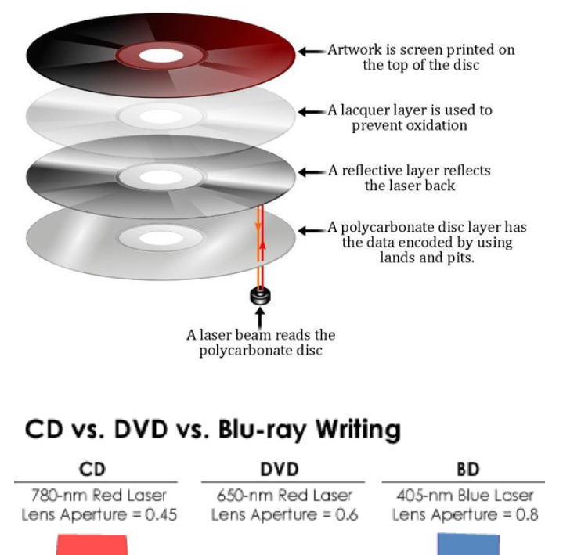
Data Storage on Optical Disks

Slide 49
Data Storage and Reading-Optical Disks
Compact discs are consists of four layers of materials. From bottom to top, the layers are a polycarbonate layer, a reflective layer, a surface of lacquer and a screen layer to place artwork or lettering of the CD cover.
CDs are optical storage media with 3.5 inch floppy drives and hard drivers store data by magnetically encoding in the disc.
CD stores data as bumps until the reflective surface. Every switch between a bump and a flat surface on the disc translates to binary codes of 1s and 0s.
CDs contain 650 to 600 MB of data, and DVD has more storage spaces due to the more number of the layers, they can hold about 2 GB of data.
The data compose a spiral way from the center of the disc. The CD/ DVD ROM drive recognizes this format and can read data.
Data Reading: Data is written to an optical disk in a radial pattern starting near the center.
An optical disk drive uses a laser beam to read the data from the disk as it is spinning. It distinguishes between the pits and lands based on how the light reflects off the recording material.
The drive uses the differences in reflectivity to determine the 0 and 1 bits that represent the data.

Slide 50
Flash memory
Flash memory is a type of non-volatile computer storage that can be electrically erased and reprogrammed. It is primarily used in memory cards, USB flash drives, solid-state drives (SSDs), and similar devices for storage and data transfer in various electronic devices.
Types of Flash Memory:
NOR Flash
Nand Flash
3D flash memory
Here are some of its key applications:
Used in SSDs: Flash memory is used in SSDs to increase the speed of read/write of operations.
Embedded systems: Flash memory is used in embedded systems. Examples: digital cameras, camcorders, MP3 players etc.
Smartphones and tablets: Flash memory is used in smartphones and tablets.
USB drives: Flash memory is commonly used in USB drives.

